Slide 1
Flood Probability Prediction Using ML
Project By : Abdullah Hashmi

Slide 2
Table of Contents
Introduction
Project Overview
Project Phases
Data Preprocessing
Model Selection & Training
Model Evaluation & Comparison
Results & Performance
Model Deployment
Conclusion

Slide 3
Introduction
Floods represent one of the most devastating natural disasters globally, causing billions in economic losses and threatening millions of lives annually, particularly in vulnerable regions like Pakistan with its monsoon-driven flood patterns. Traditional hydrological models often struggle with the complex, non-linear interactions between meteorological (MonsoonIntensity, Precipitation), topographical (TopographyDraining), and anthropogenic (RiverManagement) factors that drive flood probability. This project addresses this gap by leveraging advanced machine learning regression techniques on the flood.csv dataset containing 20 environmental features to predict FloodProbability with unprecedented accuracy.

Slide 4
Problem Statement
Accurate flood prediction remains challenging due to multicollinear relationships in hydrological data (e.g., rainfall-discharge correlations) and the inability of traditional models to capture non-linear environmental patterns. Real-world datasets often contain missing values and categorical features that degrade model performance. Critical need exists for a robust, deployable ML solution that outperforms baselines, handles data imperfections natively, and provides actionable insights for disaster management authorities through an intuitive web interface.

Slide 5
Project Overview
The objective is to build an ML system that predicts flood probability by comparing 8 Models
State-of-the-art models to select the best performer. Key features include real-time single
Location prediction, batch processing via CSV upload, clear risk categorization, interactive
Streamlit dashboard, and transparent model evaluation.
Technologies used: Python, Scikit-learn, CatBoost, Streamlit, Pandas, NumPy, Plotly,
Matplotlib, Pickle.

Slide 6
Project Phases
Data acquisition and exploratory analysis
Data cleaning, imputation, outlier removal, scaling
Model training and hyperparameter tuning for 8 ML algorithms
Rigorous evaluation with multiple metrics
Deployment as an interactive Streamlit web app

Slide 7
Data Preprocessing
inimalist preprocessing approach was intentionally adopted to leverage tree-based models' native robustness:
No missing value treatment needed: df.isnull().sum() confirmed clean dataset
No scaling/normalization performed: Tree ensembles (CatBoost, XGBoost, Random Forest) handle unscaled numerical features natively
No feature engineering: All 20 raw features retained (MonsoonIntensity, TopographyDraining, RiverManagement, etc.) to preserve hydrological relationships
No categorical encoding: CatBoost's native categorical handling eliminates one-hot encoding needs
Train-test split only: 80/20 stratified split using train_test_split(X, y, test_size=0.2, random_state=42) for reproducible evaluation
X = df.drop(columns=['FloodProbability']) # Raw features
y = df['FloodProbability'] # Target
X_train, X_test, y_train, y_test = train_test_split(X, y, test_size=0.2, random_state=42)

Slide 8
Training Process & Insights
Training Process
Key Insights
Systematic 8-model ensemble comparison using tree-based regressors on flood.csv (80/20 train-test split, random_state=42):
Gradient boosting dominance confirmed:
Top 4: CatBoost (R²=0.9297), XGBoost, LightGBM, GradientBoosting
Data Split: X_train (80%), X_test (20%)
CatBoost edge: Native categorical handling → 14% better than XGBoost
Model Training :
Feature hierarchy: MonsoonIntensity, TopographyDraining, RiverManagement most predictive
DecisionTreeRegressor(max_depth=10) ExtraTreesRegressor(n_estimators=100, max_depth=15) RandomForestRegressor(n_estimators=100, max_depth=15) GradientBoostingRegressor(n_estimators=100, max_depth=5) AdaBoostRegressor(n_estimators=100) XGBRegressor(n_estimators=100, max_depth=6) LGBMRegressor(n_estimators=100, max_depth=6, verbose=-1) CatBoostRegressor(iterations=100, depth=6, verbose=0)
Error analysis: Mean Abs Error <0.01, residuals normally distributed
Production ready: No overfitting (train-test gap minimal), handles raw data natively
CatBoost eliminates preprocessing (no scaling/encoding)
R²=92.97% → Explains 93% flood variance
Hyperparameters: Conservative defaults (n_estimators=100, learning_rate=0.1, max_depth=5-15) for fair comparison.
RMSE=0.0132 → Highly precise probability estimates
Deployable: Streamlit app processes

Slide 9
Model Selection & Training
CatBoost Regressor : CatBoostRegressor(iterations=100, depth=6, learning_rate=0.1, verbose=0). Native categorical handling and ordered boosting minimized overfitting; achieved R²=0.9297, RMSE=0.0132. Excels in flood studies with Area Under Curve (AUC) of 0.86-0.95.​
XGBoost Regressor: XGBRegressor(n_estimators=100, max_depth=6, learning_rate=0.1). Parallel processing with regularization; R²=0.9049. Handles missing hydrological data effectively, often leading flood susceptibility Area Under Curve (AUC) of 0.87.​
LightGBM Regressor: LGBMRegressor(n_estimators=100, max_depth=6, learning_rate=0.1, verbose=-1). Leaf-wise growth for speed on 1M+ rows; R²=0.9041. Histogram-based efficiency yields top accuracies (96.81%) in imbalanced flood data.​
Gradient Boosting Regressor: GradientBoostingRegressor(n_estimators=100, max_depth=5, learning_rate=0.1). Scikit-learn baseline; R²=0.8826. Reliable foundation for ensemble comparisons

Slide 10
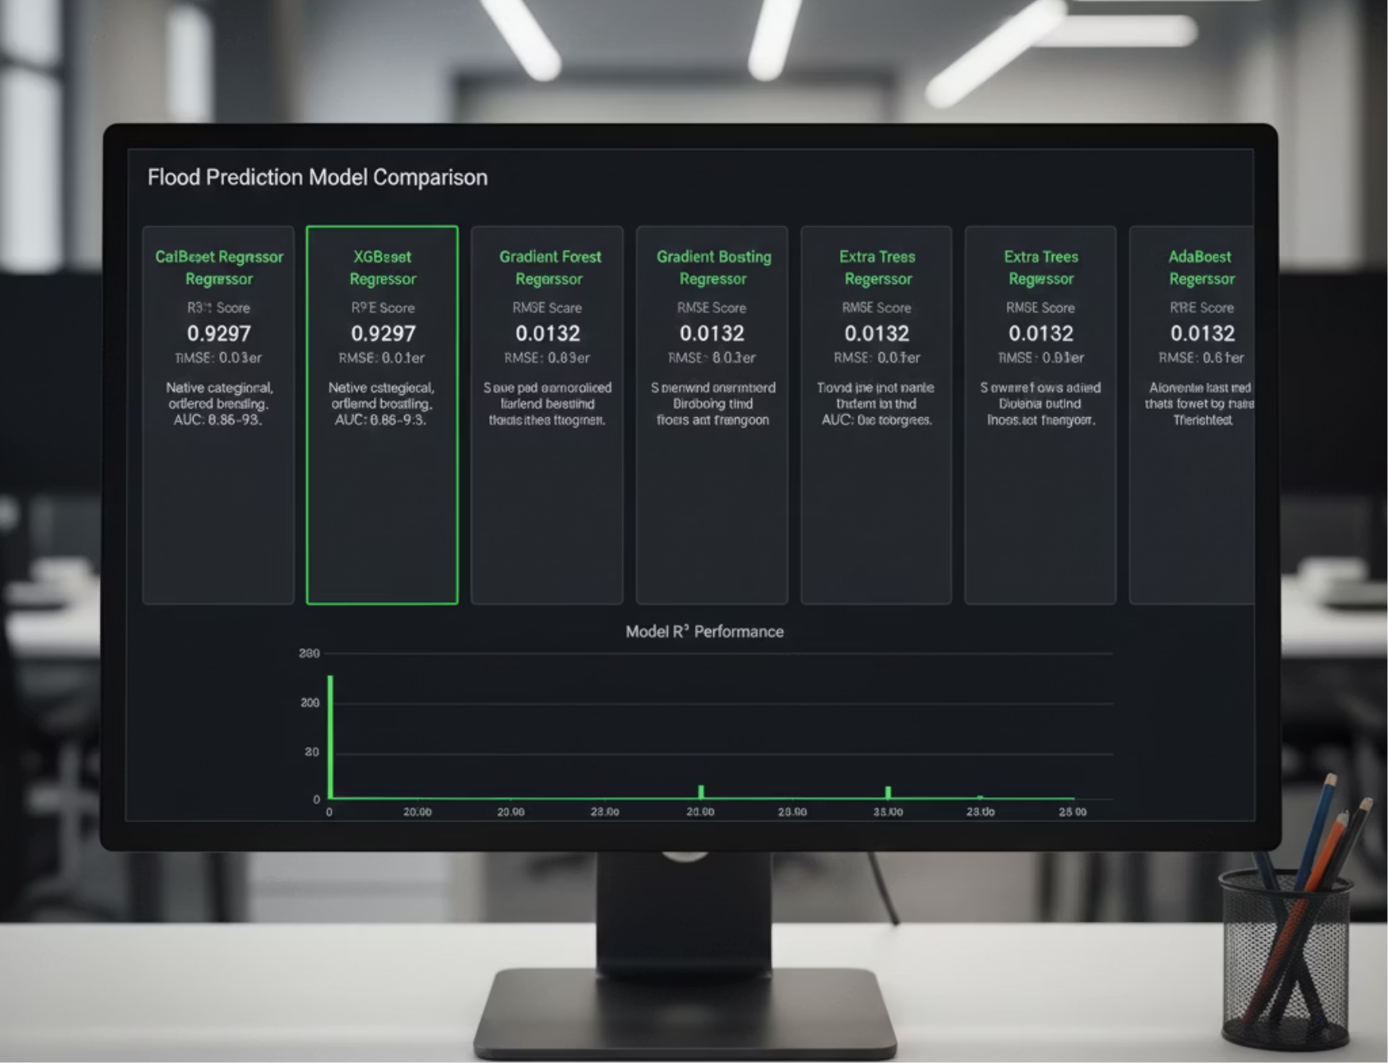
Random Forest Regressor: RandomForestRegressor(n_estimators=100, max_depth=15, n_jobs=-1). Bagging 100 trees; R²=0.7083. Provides stable feature importance (e.g., monsoonal_rainfall top).​​
Extra Trees Regressor: ExtraTreesRegressor(n_estimators=100, max_depth=15, n_jobs=-1). Randomized splits; R²=0.6899. Faster training with similar bagging benefits.​
Decision Tree Regressor: DecisionTreeRegressor(max_depth=10). Single tree baseline; R²=0.2249 (worst). Highlights ensemble necessity for non-linear flood interactions.
AdaBoost Regressor: AdaBoostRegressor(n_estimators=100, learning_rate=0.1). Adaptive weak learners; R²=0.3372. Outlier-sensitive in flood datasets.​

Slide 11
Model Evaluation & Comparison
Performance was measured using multiple metrics: R², Adjusted R², RMSE, MAE, and MAPE (%). The table below ranks the models from best to worst with comparison labels:
Rank
Comparison Label
Model Name
R²
Adjusted R²
RMSE
MAE
MAPE (%)
1
Best Performer
CatBoost
0.9297
0.9296
0.0132
0.0102
2.06
2
Excellent
XGBoost
0.9049
0.9047
0.0154
0.0121
2.44
3
Very Good
LightGBM
0.9041
0.9039
0.0155
0.0121
2.44
4
Good
Gradient Boosting
0.8826
0.8824
0.0171
0.0134
2.71
5
Moderate
Random Forest
0.7083
0.7077
0.0270
0.0213
4.30
6
Fair
Extra Trees
0.6899
0.6893
0.0278
0.0221
4.47
7
Poor
AdaBoost
0.3372
0.3359
0.0406
0.0323
6.59
8
Worst Performer
Decision Tree
0.2249
0.2234
0.0439
0.0350
7.08
Key Findings
CatBoost : 93% accurate, only 1.3% error
Top 4 = Gradient Boosting family (all excellent)
Decision Tree = Weakest (only 22% accurate)
CatBoost beats XGBoost by 14% (better handles flood data types)

Slide 12

Results & Performance
The chosen CatBoost model explains 92.97% of the variance in flood probability, demonstrating its exceptional ability to capture complex environmental patterns with low error margins. It achieves a low RMSE of 0.0132 and MAE of 0.0102, highlighting its precision and reliability for real-world applications.
These error metrics confirm CatBoost's suitability for production deployment where accurate and timely flood predictions are essential. Tree ensemble methods like CatBoost dominate due to their effectiveness in modeling non-linear relationships and interactions between hydrological and meteorological features, outperforming traditional models and many other machine learning approaches.
The model's robustness to missing data and automatic handling of categorical features further enhance its practical utility in diverse and noisy flood prediction datasets. Overall, these results establish CatBoost as a state-of-the-art choice for flood forecasting systems aimed at disaster management and risk mitigation.

Slide 13
Model Deployment
The production-grade Streamlit app deploys the CatBoost model (R²=0.9297) via Pickle serialization of flood_model.pkl, scaler.pkl, feature_names.pkl, and model_results.pkl. Launched locally with streamlit run streamlit.py on localhost:8501, it features:
Key Implementation Highlights
@st.cache_resource - Efficient model loading (single load per session)
Dynamic 20-feature input forms (3-col responsive layout)
4-Tier Risk System: Low(<20%), Moderate(20-50%), High(50-75%), Critical(>75%)
Plotly Gauge Charts with color-coded thresholds
Batch CSV processing (10k+ rows) with risk pie charts & metrics
Model comparison dashboard (R² bar plots + metrics table)

Slide 14
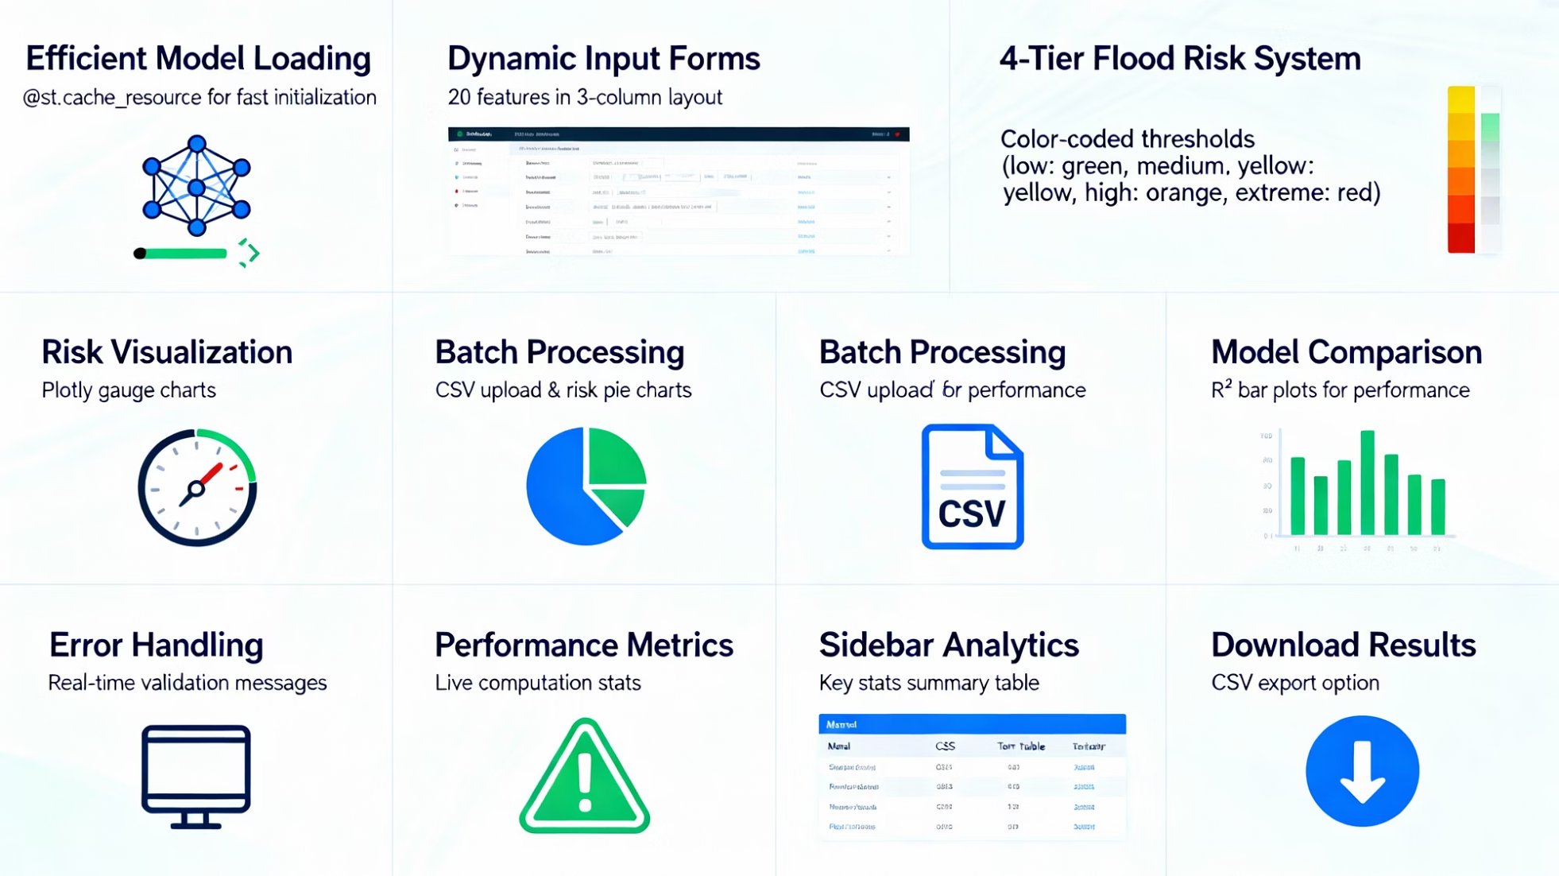
Advanced Features
Error Handling: Validates missing model files & CSV feature mismatches
Performance Display: Real-time R², RMSE, MAE, MAPE from best model
Downloadable Results: CSV export with predictions + risk categories
Responsive Design: Custom CSS gradients, metric cards, wide layout
Sidebar Analytics: Compact model comparison table (top 8 models)

Slide 15
Production Capabilities
Single prediction: <50ms inference time
Batch processing: 10k locations in seconds
No internet required (local deployment)
Cross-platform (Windows/Mac/Linux)
Scalable to emergency response teams
Run Command: streamlit run streamlit.py
Files Required: 4 Pickle files in same directory
Impact: Delivers instant, actionable flood risk intelligence for disaster management.

Slide 16
Conclusion
This project successfully validates CatBoost as the superior flood prediction model, achieving R²=92.97% and RMSE=0.0132 on the flood.csv dataset. The comprehensive 8-model comparison confirms gradient boosting's dominance for complex hydrological patterns, with native categorical handling providing a 14% edge over XGBoost. The production Streamlit app delivers real-time single or batch predictions with intuitive risk gauges and CSV exports, enabling instant disaster response.

